Slide 1


Configurable Tabs in Microsoft Teams (Extended lab)

Slide 2
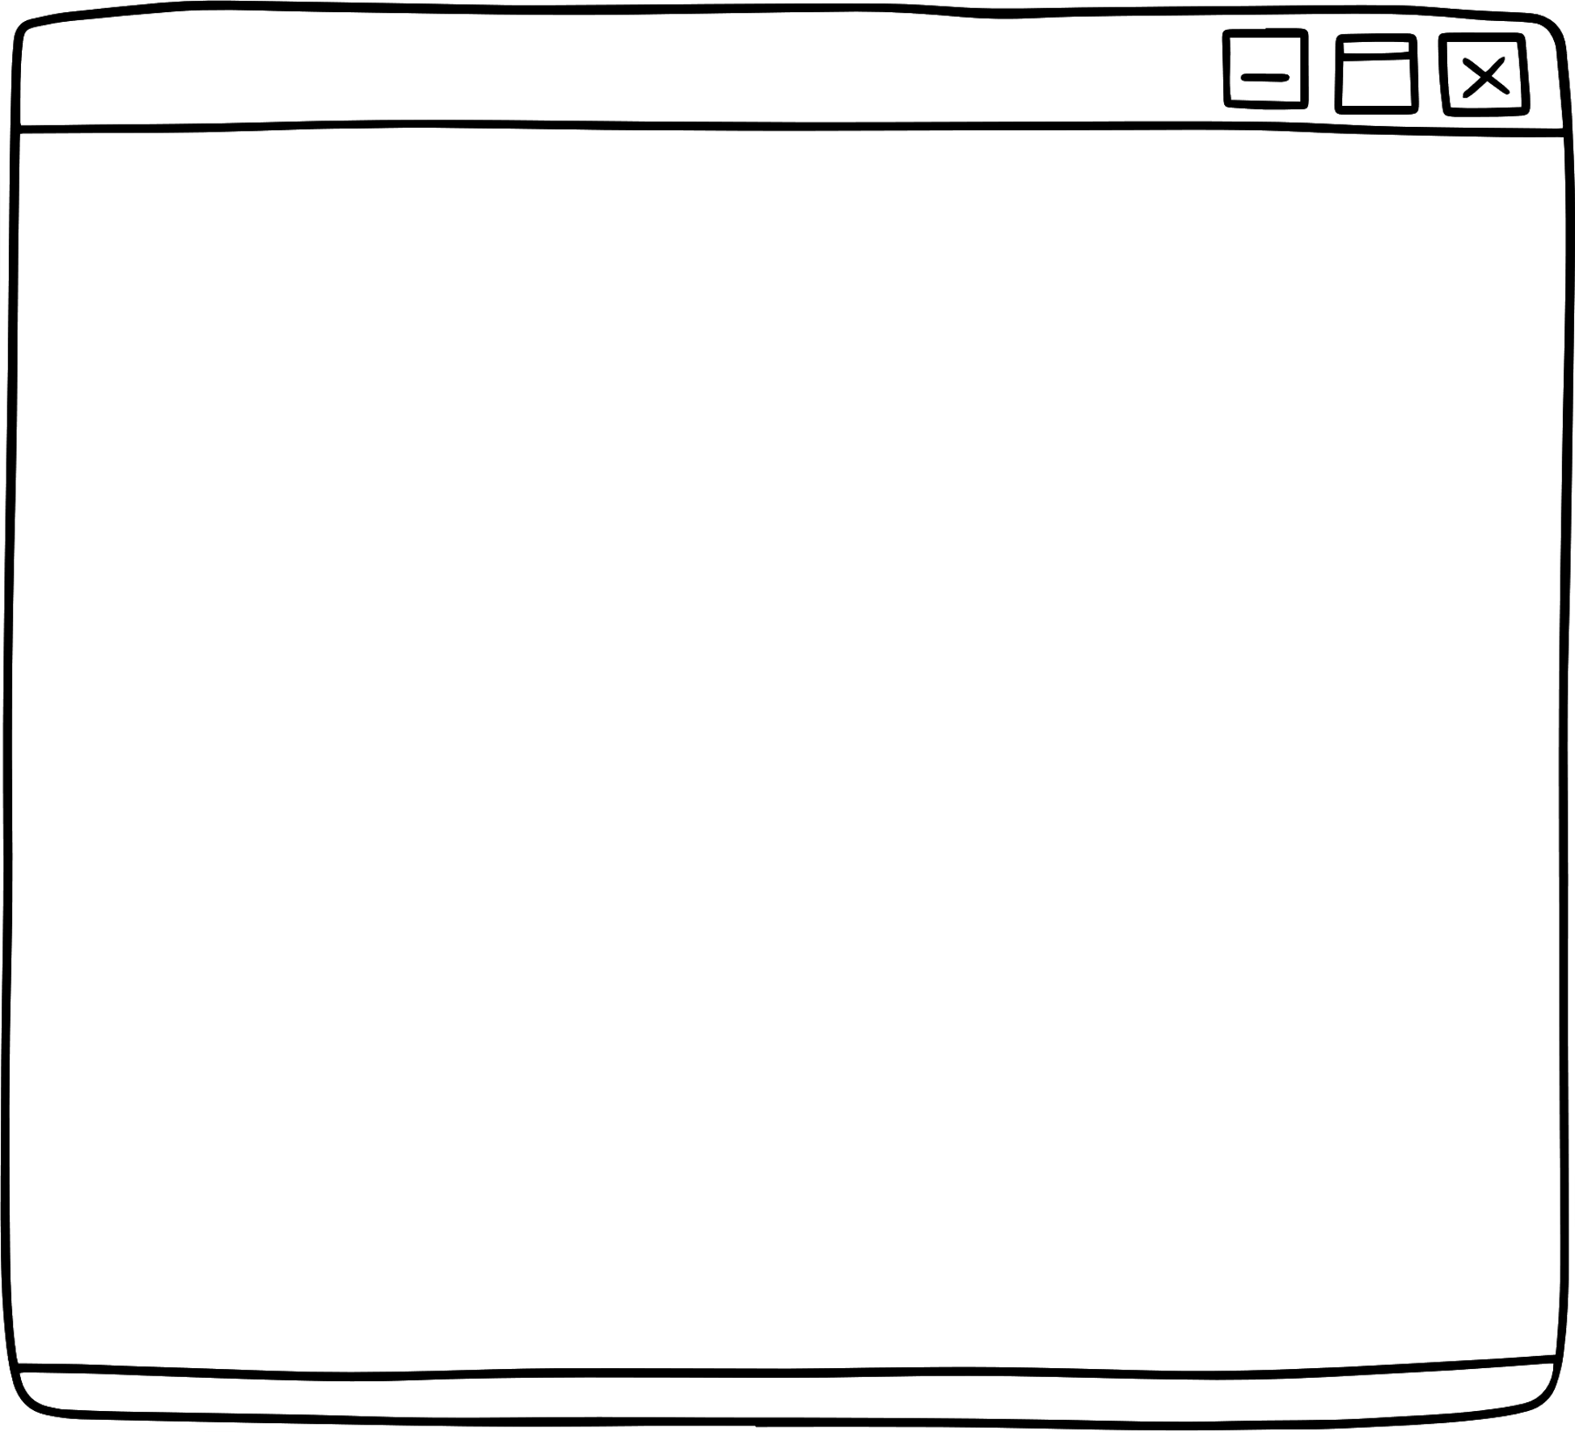

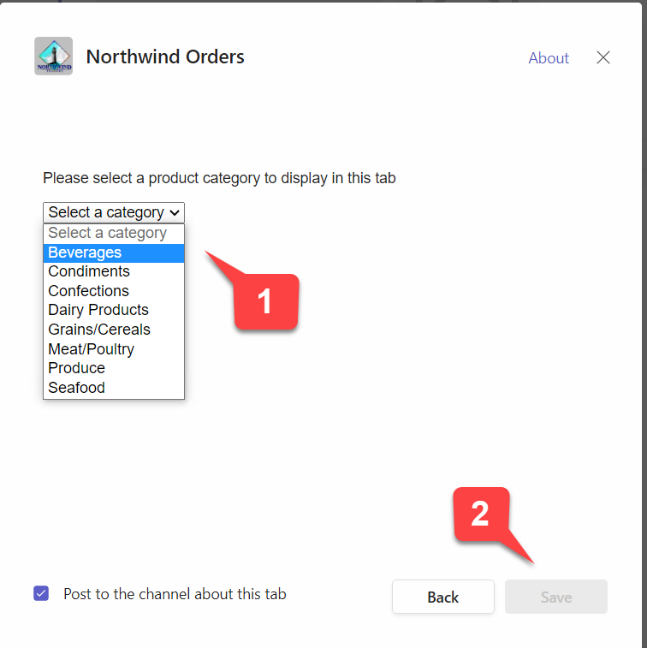
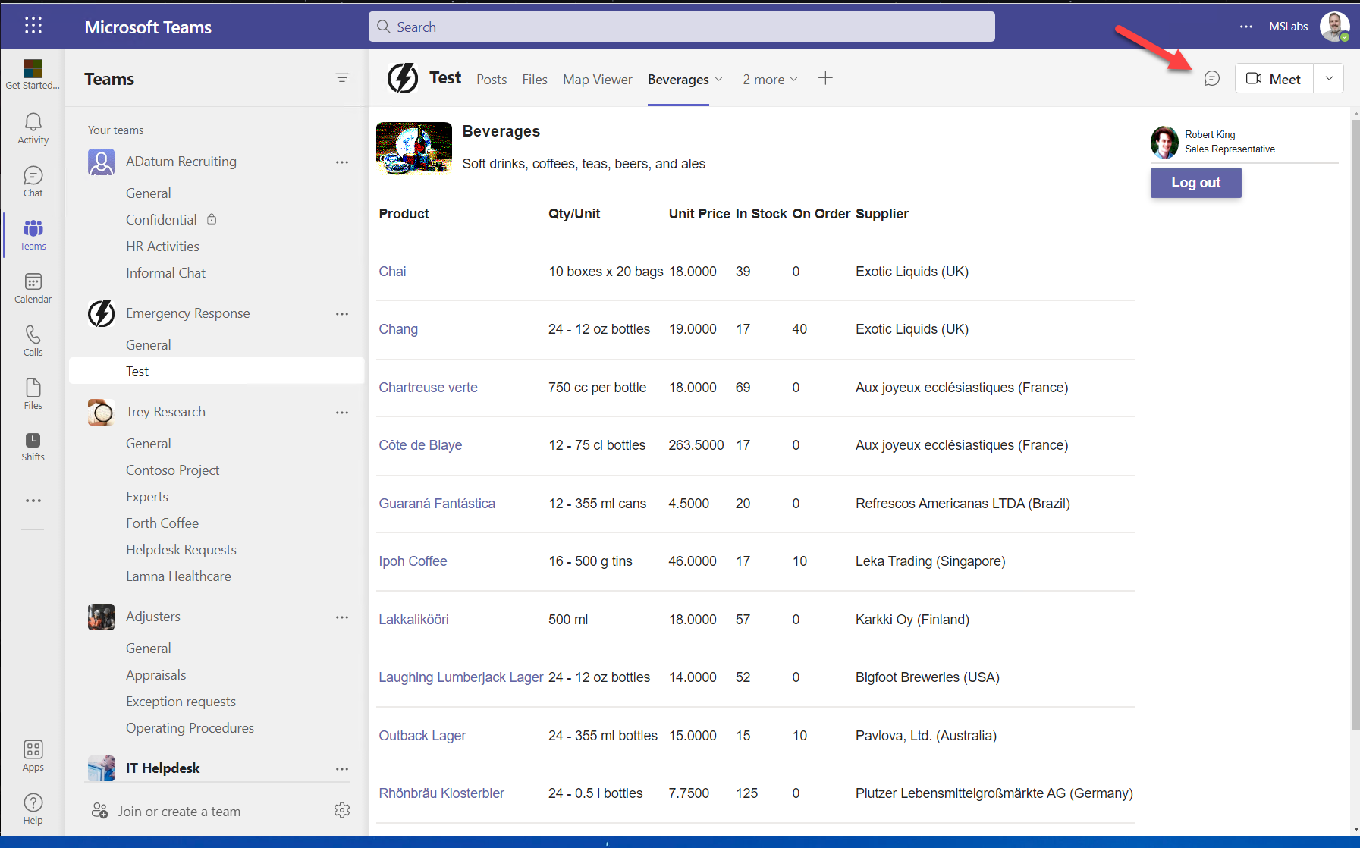
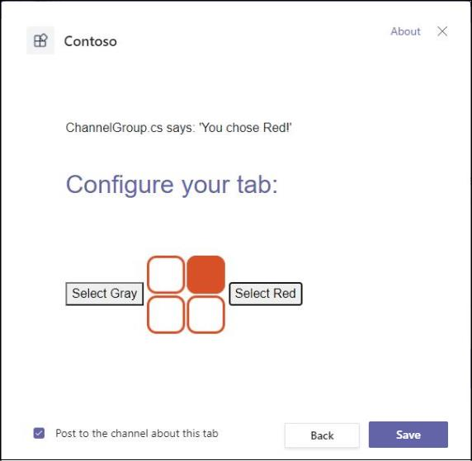
What’s a configurable tab?
Configurable tabs are required for tab apps deployed into a team, a group chat or a meeting
You can collect user inputs in a configuration page and pass those settings to your tab app
Step 1
Step 2
Step 3
User select the app to install
Teams SDK 2.0 is initialized
>app.initialize();
“Saved” button is grayed
User configure the app
e.g. color = Grey or Red
Value is saved via Teams SDK
>pages.config.setConfig();
“Saved” button is activated
User accesses the app
App is configured based on user settings
Configuration settings can be changed at any time (if authorized)

Slide 3
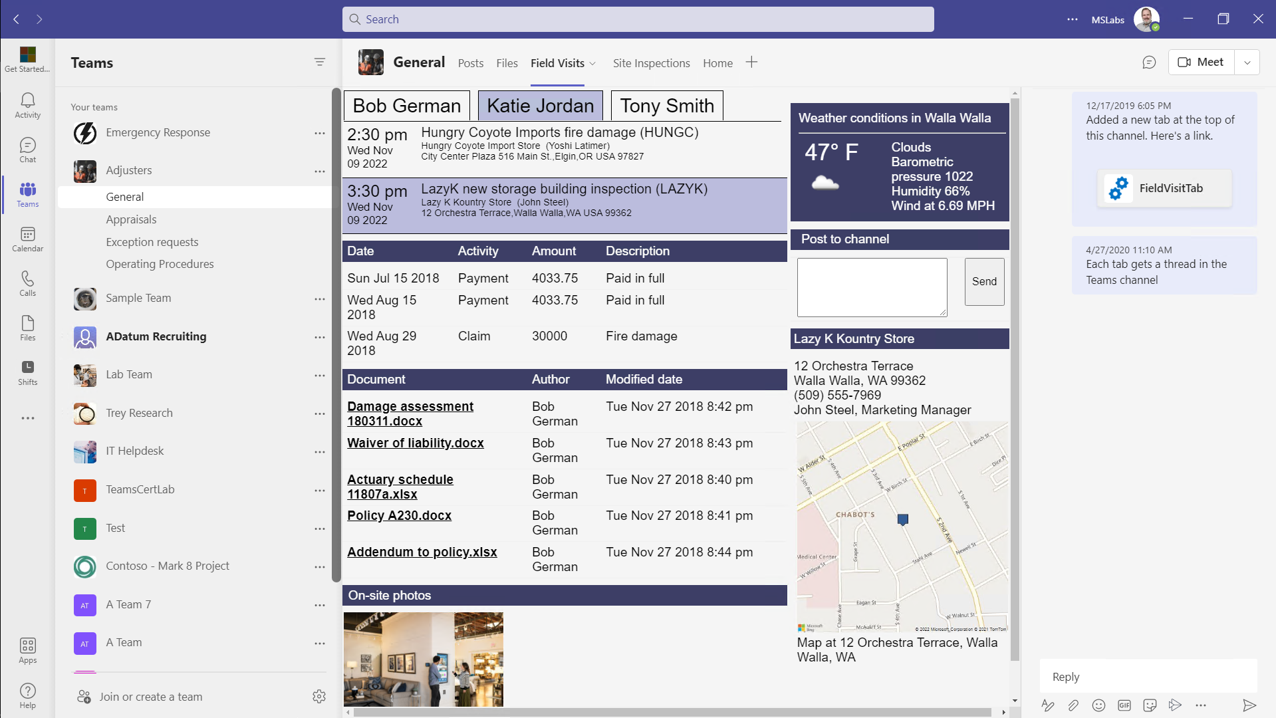
Configurable Tabs
Your tab is available in collaborative environments such as group chats and Teams channels
Users can configure your tab to display information that’s relevant to the chat or channel topic
Collaboration
Discoverability
Admins can Include apps in Team Templates so they’re automatically installed in new Teams
Users can configure the tab to show relevant information
Once the tab is configured, it brings users directly to relevant information
Users can chat alongside the application
New tabs are announced in the conversation, drawing users in
Notes:
Suggested demo: Create a Beverages team and add a Beverages tab from the Northwind Orders app

Slide 4

demo
Notes:
Lab demonstration:
- Run the completed configuration lab; insert the tab into a Teams channel or group conversation and show the configuration experience
- Show the file /client/pages/tabConfig.js -- Point out the call to microsoftTeams.settings.setValidityState(true); which is called when the user has selected a valid product category. This enables the save button. -- Point out the call to microsoftTeams.pages.config.registerOnSaveHandler(). The callback from this function will run when a user clicks the save button. Notice that it shows the category name in the tab’s entity ID and URL; a more complex application could store settings in its own database and use the entity ID and/or URL to hold a locator for that data

Slide 5
LAB TIME https://aka.ms/app-camp Please do the Configurable Tabs lab
Notes:
Note there is a video for each lab showing a complete walk-through

Slide 6

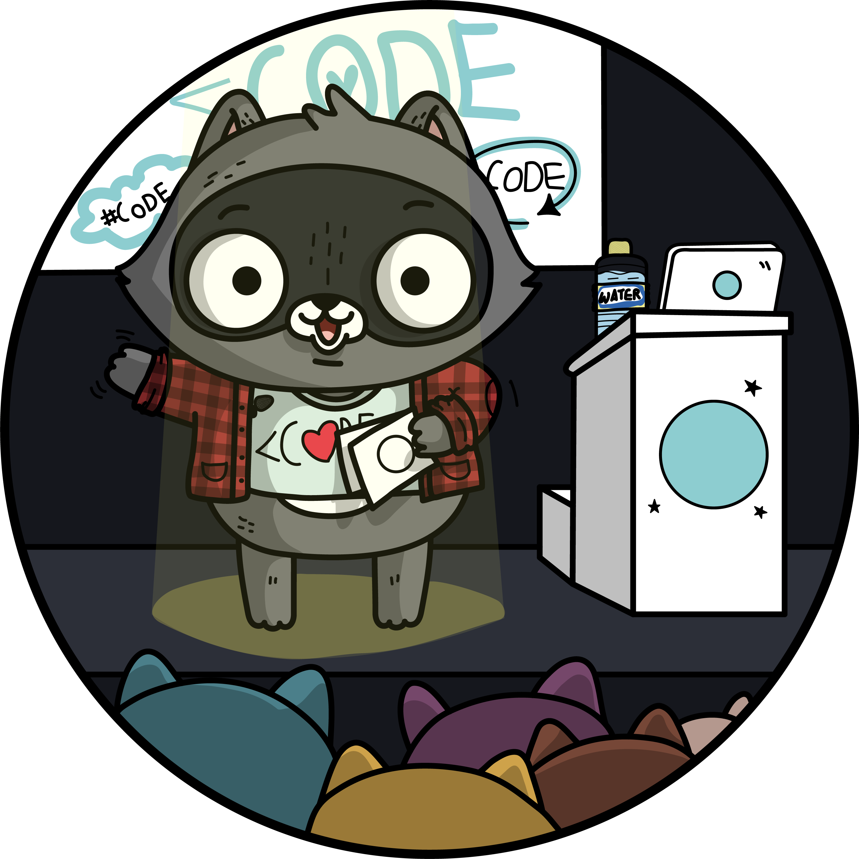


Lab Structure
Core Lab (path A)
App setup
Add tab with SSO
Add look and feel
Migrate an Azure AD Web App to Teams
start
Personal tab with
Azure AD SSO
Core Teams Application
Configurable
tab
Deeplinks
Dialog
Message Extension w/Adaptive Cards
Monetization
Meeting App
Extend capabilities
Notes:
ASK ONE OF THE PARTICIPANTS TO DEMO THE APP
A good next lab is the “Meeting app”, which builds on the completed configurable tab lab.

